Slide 1

Data Science
Module: 1 – Descriptive & Inferential Statistics

Slide 2
Module: 1 – Descriptive & Inferential Statistics
1.Turning Data into Information
✓ Data Visualization
✓ Measures of Central Tendency
✓ Measures of Variability
✓ Measures of Shape
✓ Covariance, Correlation
✓ Using Software-Real Time Problems
2.Probability Distributions
✓ Probability Distributions: Discrete Random Variables
✓ Mean, Expected Value
✓ Binomial Random Variable
✓ Poisson Random Variable
✓ Continuous Random Variable
✓ Normal distribution
✓ Using Software-Real Time Problems
3.Sampling Distributions
✓ Central Limit Theorem
✓ Sampling Distributions for Sample Proportion, p-hat
✓ Sampling Distribution of the Sample Mean, x-bar
✓ Using Software-Real Time Problems
4.Confidence Intervals
✓ Statistical Inference
✓ Constructing confidence intervals to estimate a population Mean, Variance, Proportion
✓ Using Software-Real Time Problems
5.Hypothesis Testing
✓ Hypothesis Testing
✓ Type I and Type II Errors
✓ Decision Making in Hypothesis Testing
✓ Hypothesis Testing for a Mean, Variance, Proportion
✓ Power in Hypothesis Testing
✓ Using Software-Real Time Problems
6.Comparing Two Groups
✓ Comparing Two Groups
✓ Comparing Two Independent Means, Proportions
✓ Pairs wise testing for Means
✓ Two Variances Test(F-Test)
✓ Using Software-Real Time Problems
7.Analysis of Variance (ANOVA)
✓ One-Way and Two-way ANOVA
✓ ANOVA Assumptions
✓ Multiple Comparisons (Tukey, Dunnett)
✓ Using Software-Real Time Problems
8.Association Between Categorical Variables
✓ Two Categorical Variables Relation
✓ Statistical Significance of Observed Relationship / Chi-Square Test
✓ Calculating the Chi-Square Test Statistic
✓ Contingency Table
✓ Using Software-Real Time Problems

Slide 3
Problem Statement
Indian government planning to issue a notification for SI post
Job Profile :
1. Indian
2.Male
3.Graduate
4.Age (20-25)
5.Height (__-__)
The average population Hight 169.929088
is falls in between below intervals
Lower Limit 167.2413881
Upper Limit 171.3358923
5.Height (167 - 171)

Slide 4
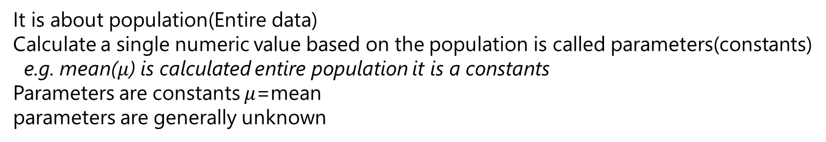
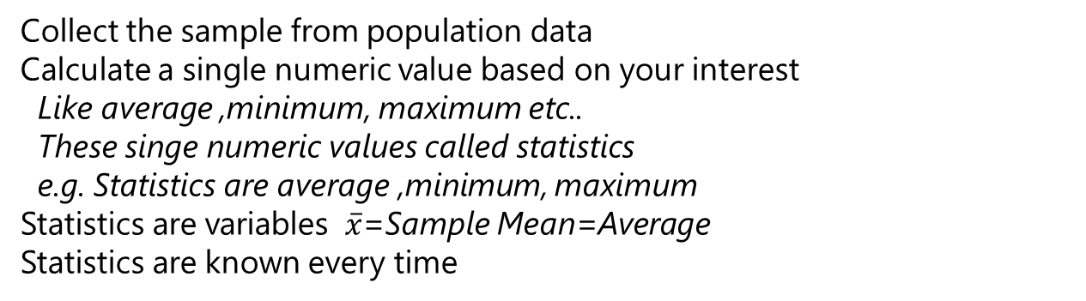
Difference Between Descriptive & Inferential Statistics
Collect the sample from population data
Calculate a single numeric value based on your interest
Like average ,minimum, maximum etc..
These singe numeric values called statistics
e.g. Statistics are average ,minimum, maximum
Statistics are variables $\overline{x}$=Sample Mean=Average
Statistics are known every time
Descriptive Statistics
It is about population(Entire data)
Calculate a single numeric value based on the population is called parameters(constants)
e.g. mean($μ$) is calculated entire population it is a constants
Parameters are constants $μ$=mean
parameters are generally unknown
Inferential Statistics

Slide 5


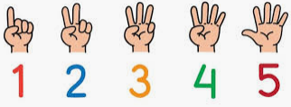
Random Variables
Continuous Random Variable
Collect the data using some instrument that data is called continuous data
It is measurable data using an instrument
e.g. Age , Currency, weight
Discreate Random Variable
Classification : Male/Female , Good/Bad
Count : No. of people in a class

Slide 6
Continuous & Discreate Data
Discreate Data :
Count : No. of defects in product
Classification : Defective product Accept/Reject
Count : No. of incidents closed per hour
Continuous Data:
Time taken to close an incidents
Problem : No. of People coming to office before 8:30 and After 8:30
2nd Way
Name | Entry time(AM)
Vinay | 8:45
Pavani | 9:20
Deepthi | 8:45
Rajesh | 9:15
Sunil | 8:50
Ashok | 8:15
2nd - Way is the best way to collect the data
Always collect the data in continuous from when ever possible otherwise there is a loss of information.
1st –Way Discrete data contains only exact values.
1st Way
<= 8:30 AM | >= 8:30 AM
75 People | 25 People

Slide 7
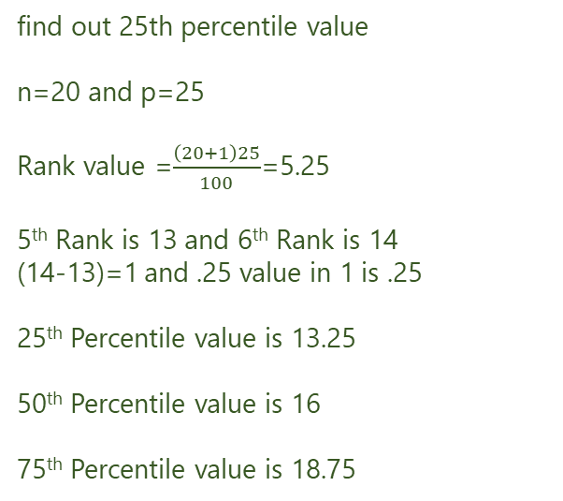
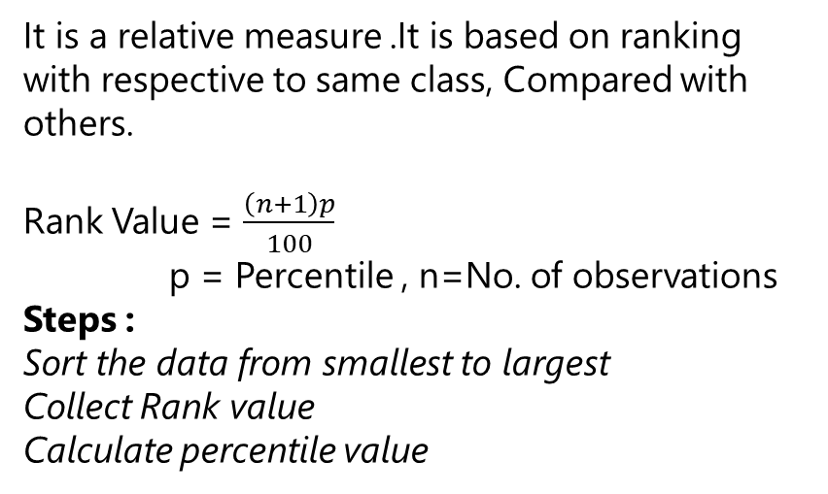
Percentile
Problem : A large department store collects data on sales made by each of its salespeople. The number of sales made on a given day by each of 20 salespeople is shown below ,the data has been sorted in magnitude
It is a relative measure .It is based on ranking with respective to same class, Compared with others.
Rank Value = $\frac{\left(n+1\right)p}{100}$
p = Percentile , n=No. of observations
Steps :
Sort the data from smallest to largest
Collect Rank value
Calculate percentile value
Sales | Sorted Sales | Rank
9 | 6 | 1
6 | 9 | 2
12 | 10 | 3
10 | 12 | 4
13 | 13 | 5
15 | 14 | 6
16 | 14 | 7
14 | 15 | 8
14 | 16 | 9
16 | 16 | 10
17 | 16 | 11
16 | 17 | 12
24 | 17 | 13
21 | 18 | 14
22 | 18 | 15
18 | 19 | 16
19 | 20 | 17
18 | 21 | 18
20 | 22 | 19
17 | 24 | 20
find out 25th percentile value
n=20 and p=25
Rank value =$\frac{\left(20+1\right)25}{100}$=5.25
5th Rank is 13 and 6th Rank is 14
(14-13)=1 and .25 value in 1 is .25
25th Percentile value is 13.25
50th Percentile value is 16
75th Percentile value is 18.75
Interpretation:
25% of people they made sales less then 13.25 and 75% of people they made sales greater than 13.25
50% of people they made sales less then 16 and 50% of people they made sales greater than 16
75% of people they made sales less then 18.75 and 25% of people they made sales greater than 18.75

Slide 8
Quartiles
Percentile 100 Parts
Decile 10 Parts
Quartile 4 Parts
Quantile n Parts
Q1 = 1st quartile = 25th percentile
Q2 = 2nd quartile = 50th percentile
Q3 = 3rd quartile = 75th percentile

Slide 9
Data Visualization
Box Plot
Line Chart
Bar Graph
Histogram
Scatter Plot

Slide 10
Box Plot
It is used to identify the outliers in the data
Outliers Abnormal data / Extreme behavior
It provides idea about central tendency of the data
It provides idea about dispersion of the data
It provides idea about shape of the data

